Slide 1

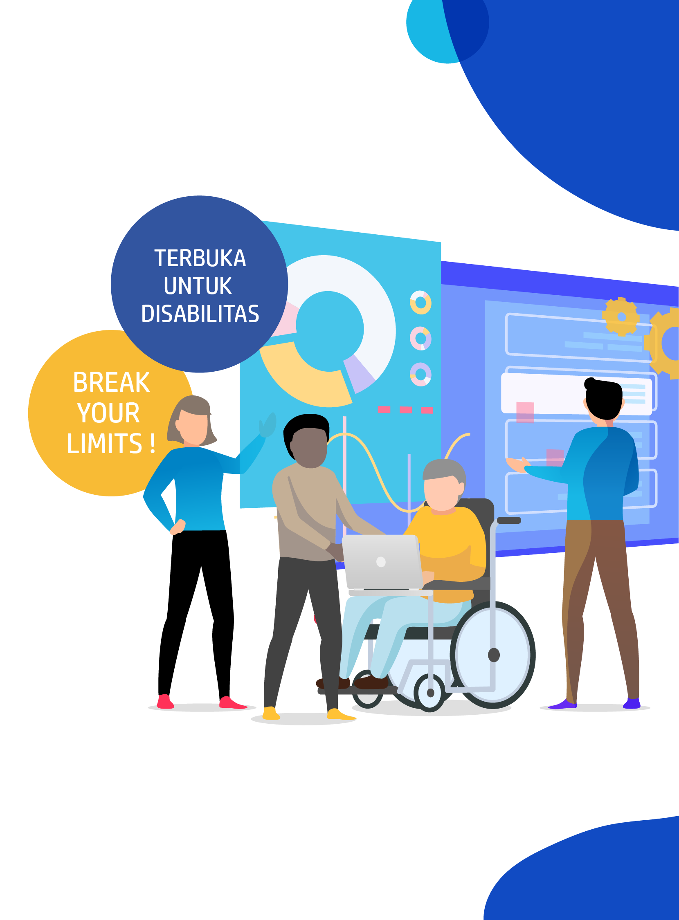




DIGITAL TALENT SCHOLARSHIP
2019
digitalent.kominfo.go.id

Slide 2
Deep Learning Models

Slide 3

Deep Belief Nets
Bagian 1

Slide 4


RBM can extract features and reconstruct inputs. but how exactly does that help with the vanishing gradient?

Slide 5
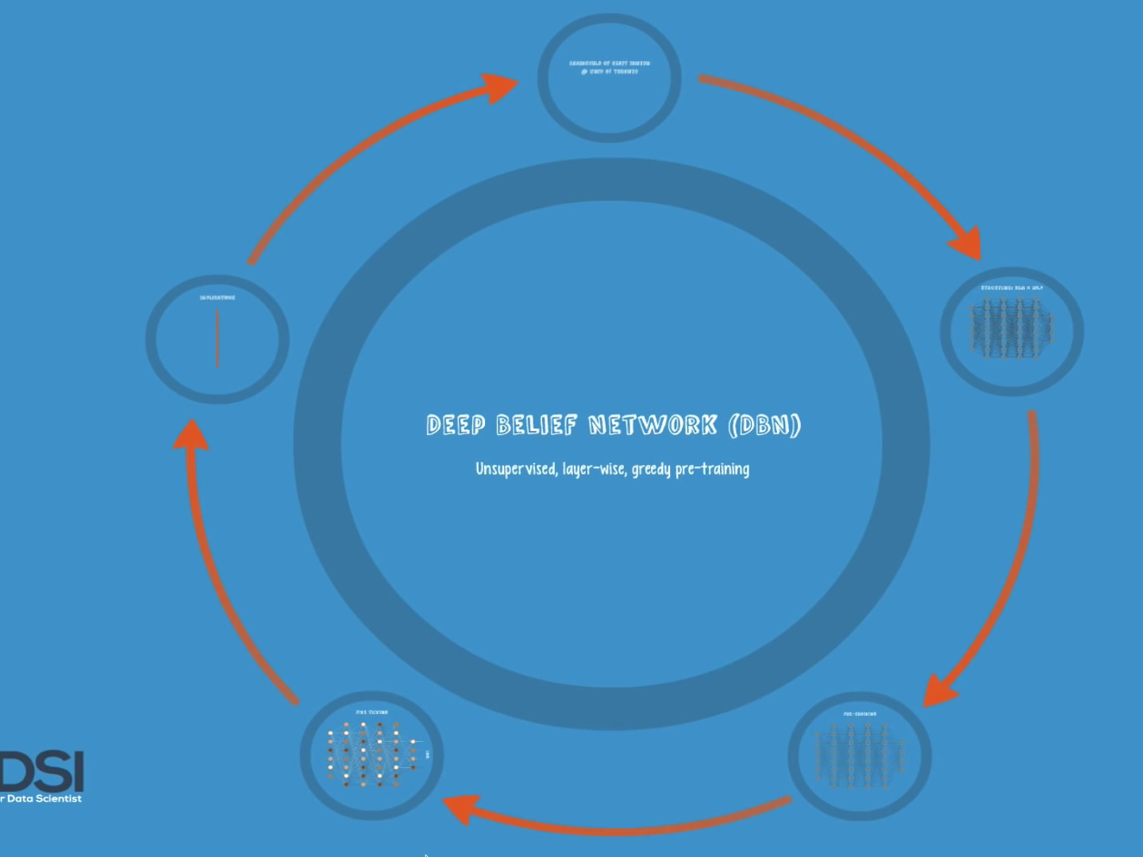
By combining RBMs together and introducing a clever training method, we obtain a powerful new model that finally solves our problem

Slide 6
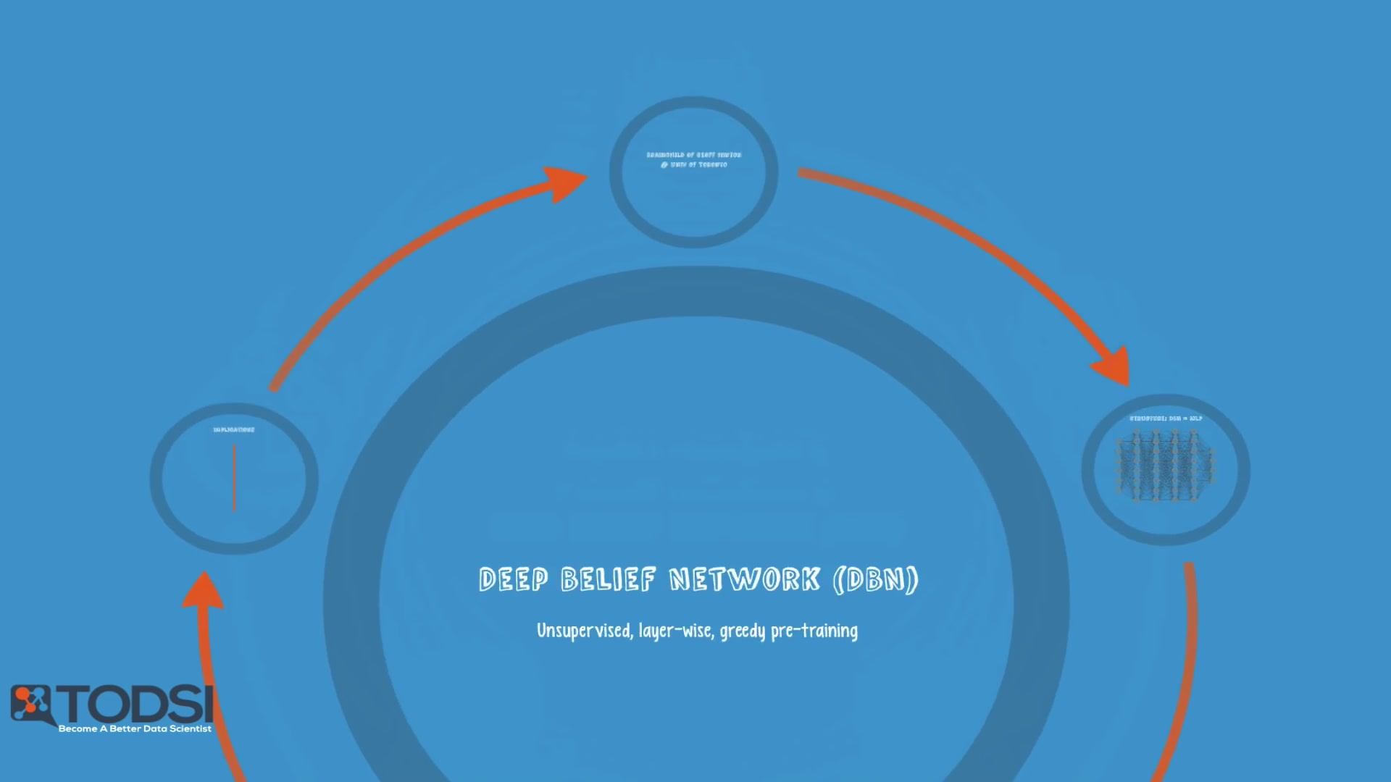
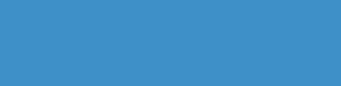
Deep Belief Network (DBN)

Slide 7


Deep Belief Nets were also conceived by Geoff Hinton as an alternative to backpropagation.

Slide 8
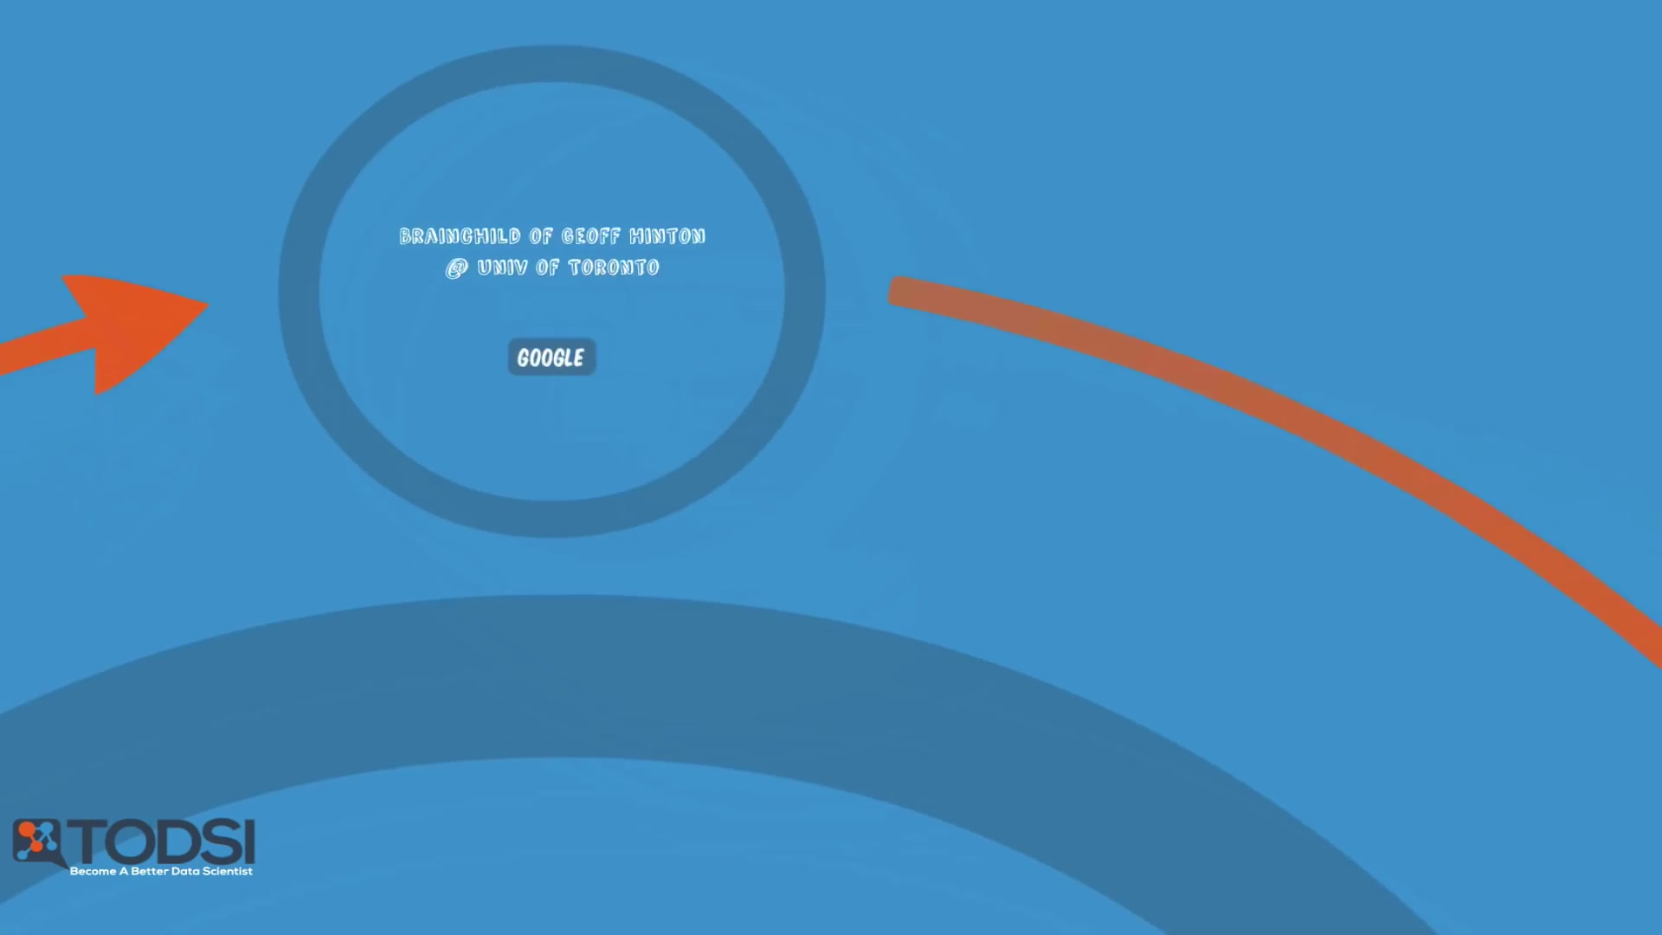
Deep Belief Network (DBN)
Notes:
Because of his accomplishments, he was hired for image recognition work at Google, where a large-scale DBN project is currently believed to be in development.

Slide 9
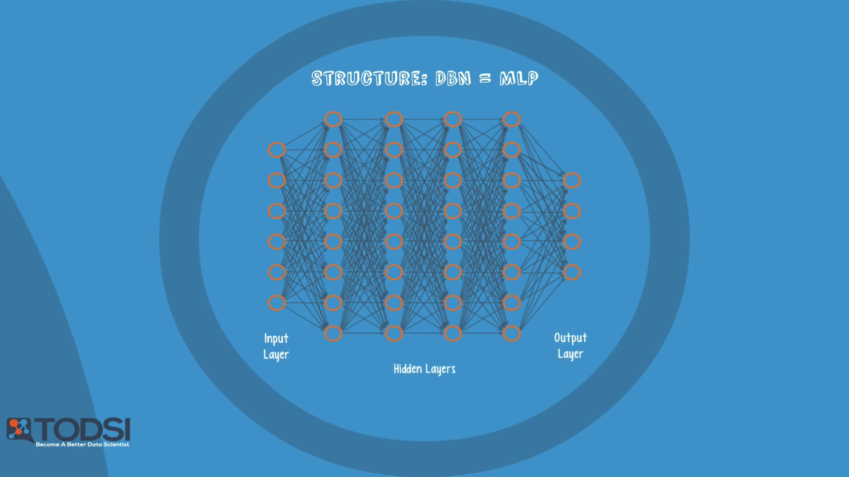
In terms of network structure, a DBN is identical to an MLP
The difference in training methods is the key factor that enables DBNs to outperform their shallow counterparts.

Slide 10
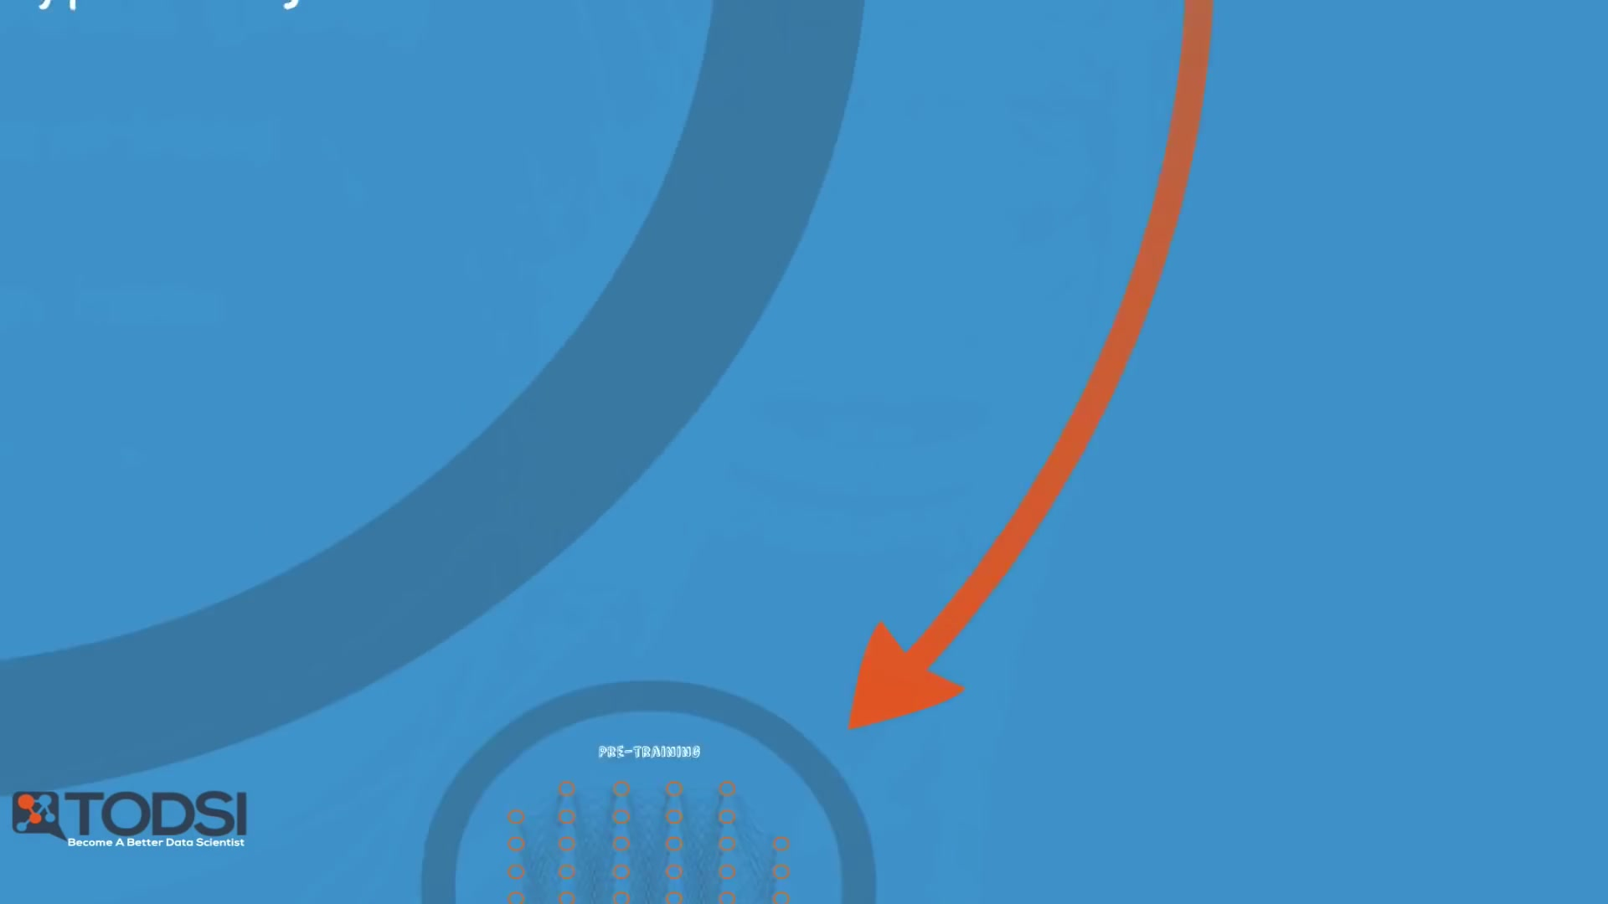
Deep Belief Network (DBN)

Slide 11
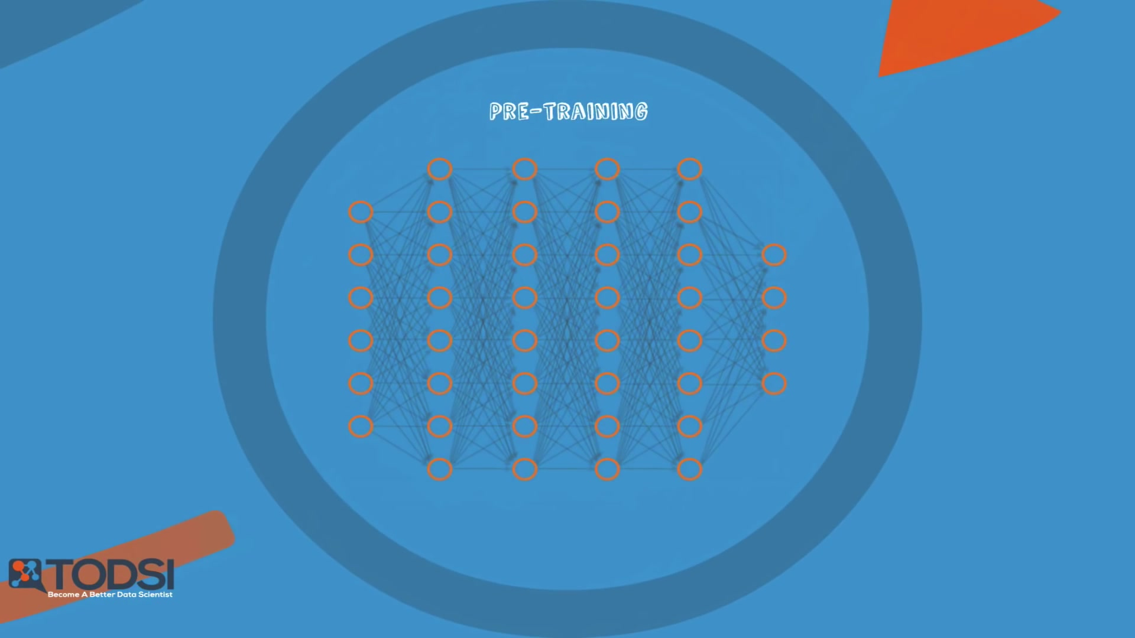
Deep Belief Network (DBN)
A deep belief network can be viewed as a stack of RBMs, where the hidden layer of one RBM is the visible layer of the one "above" it.

Slide 12
a) The first RBM is trained to re-construct its input as accurately as possible
Notes:
A DBN is trained as follows:

Slide 13
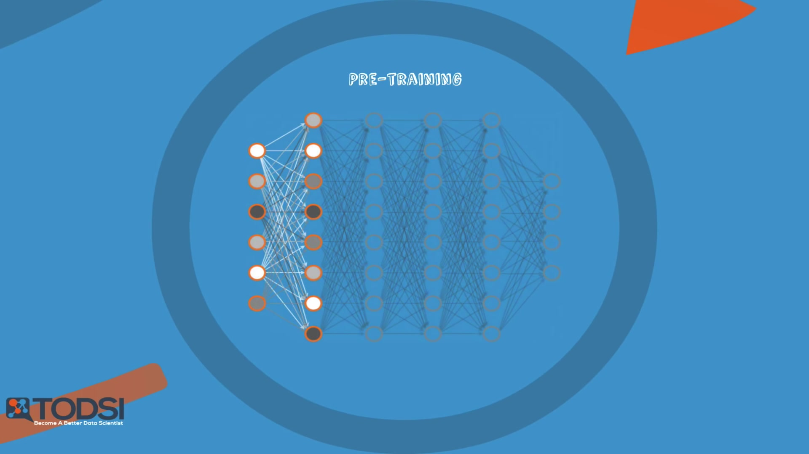
b) The hidden layer of the first RBM is treated as the visible layer for the second

Slide 14
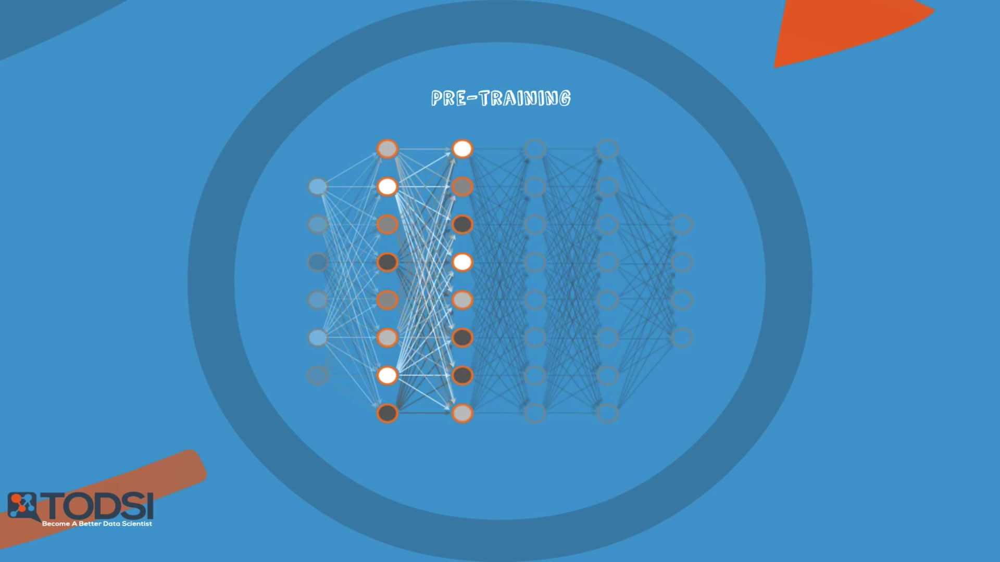
And the second RBM is trained using the outputs from the first RBM

Slide 15
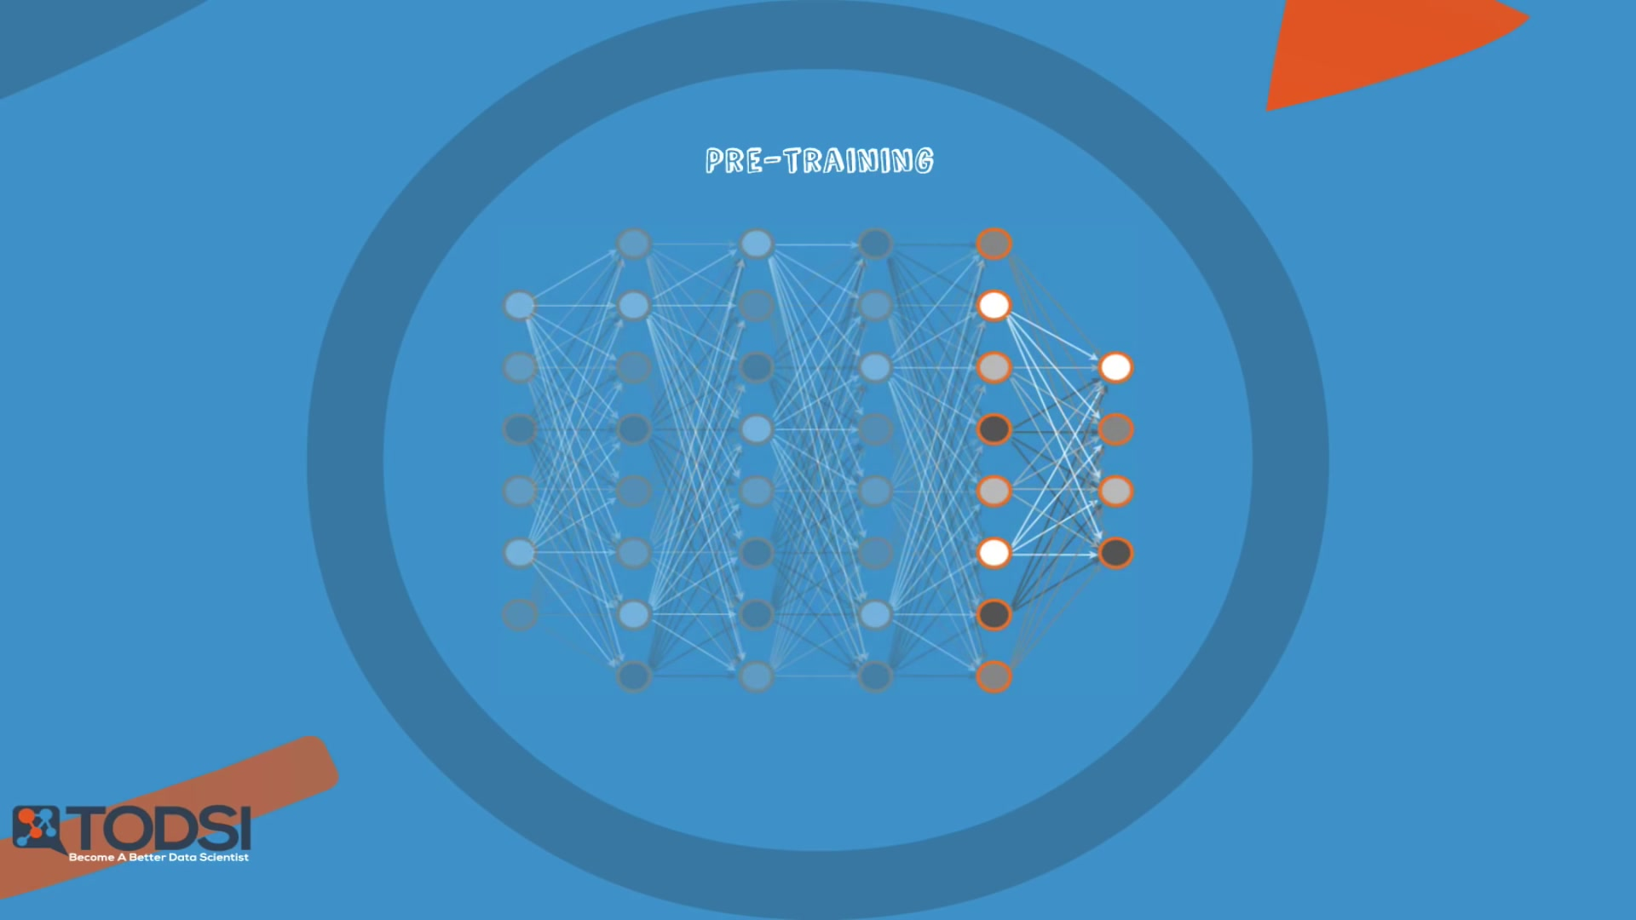
C. This process is repeated until every layer in the network is trained

Slide 16
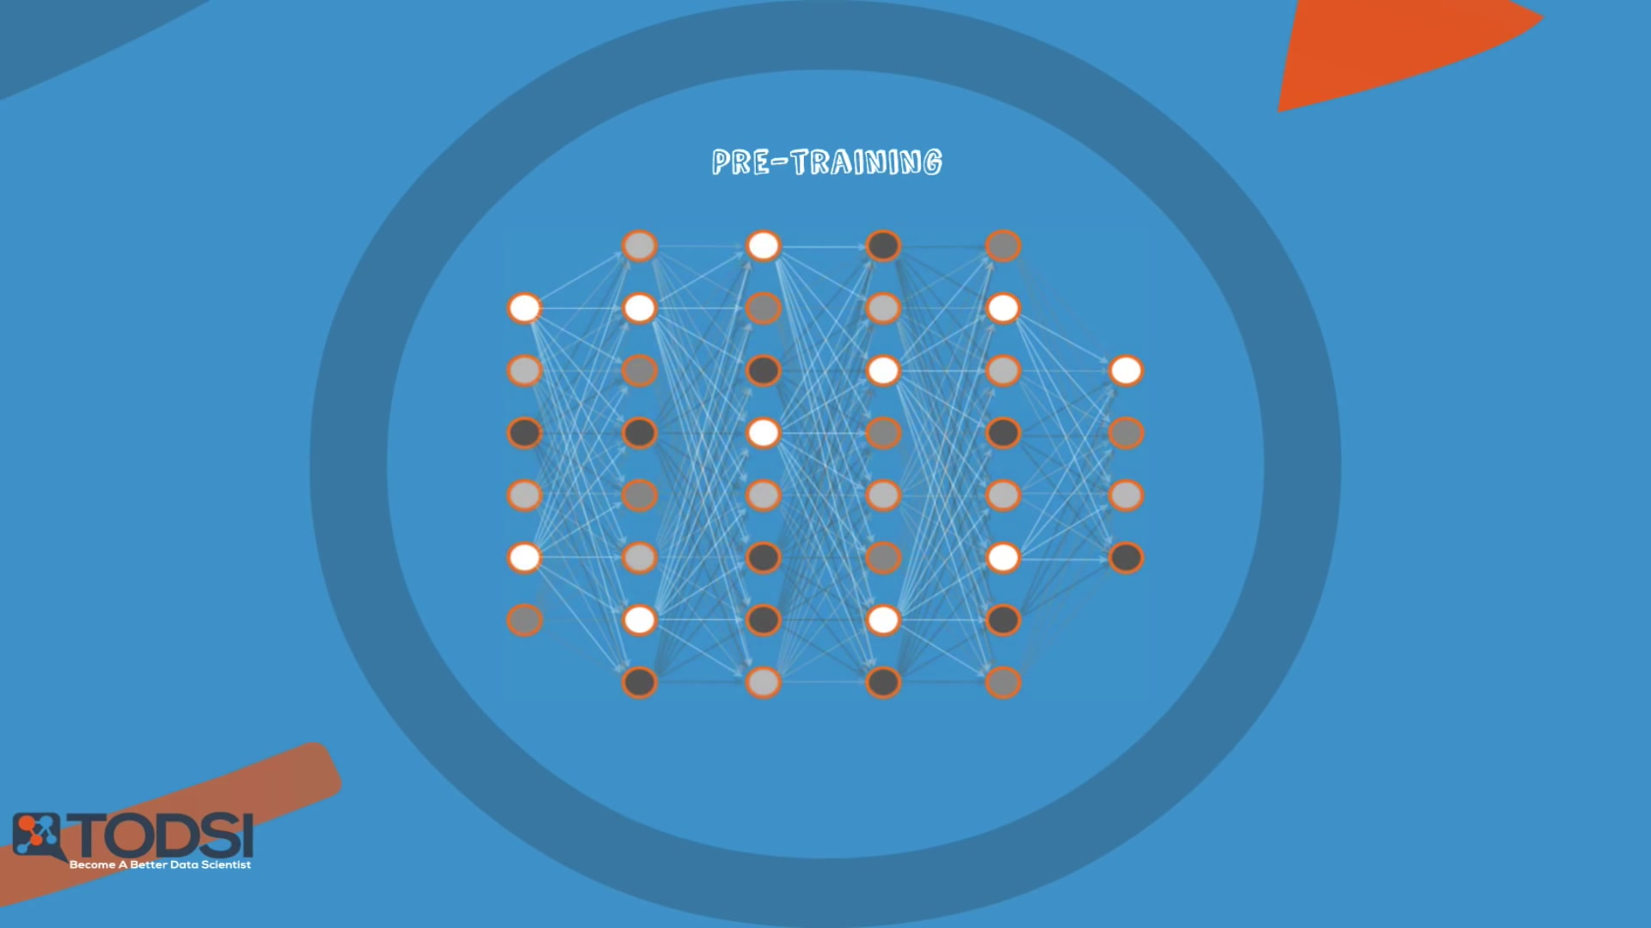
An important note about a DBN is that each RBM layer learns the entire input. In other kinds of models – like convolutional nets – early layers detect simple patterns and later layers recombine them.

Slide 17

Deep Belief Network (DBN)
A DBN, on the other hand, works globally by fine tuning the entire input in succession as the model slowly improves – kind of like a camera lens slowly focusing a picture.
The reason that a DBN works so well is highly technical, but suffice it to say that a stack of RBMs will outperform a single unit – just like a Multilayer perceptron was able to outperform a single perceptron working alone.

Slide 18
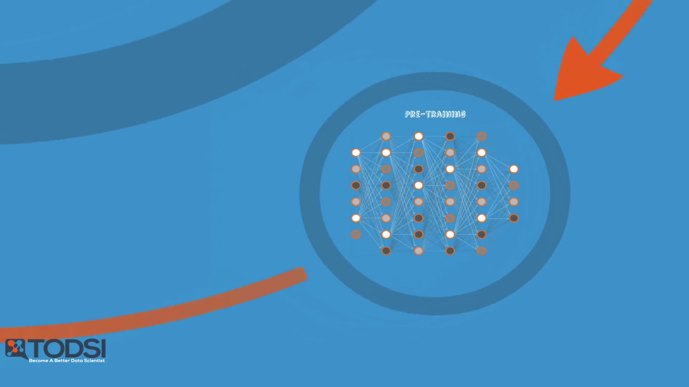
After this initial training, the RBMs have created a model that can detect inherent patterns in the data.
To finish training, we need to introduce labels to the patterns and fine-tune the net with supervised learning
Notes:
To do this, you need a very small set of labeled samples so that the features and patterns
can be associated with a name. The weights and biases are altered slightly, resulting
in a small change in the net’s perception of the patterns, and often a small increase

Slide 19
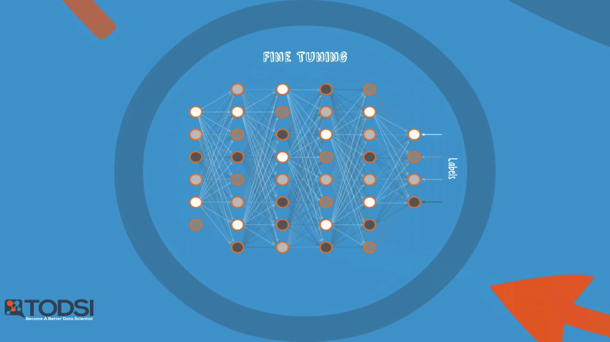
Deep Belief Network (DBN)
Notes:
To do this, you need a very small set of labeled samples so that the features and patterns can be associated with a name. The weights and biases are altered slightly, resulting in a small change in the net’s perception of the patterns, and often a small increase

Slide 20
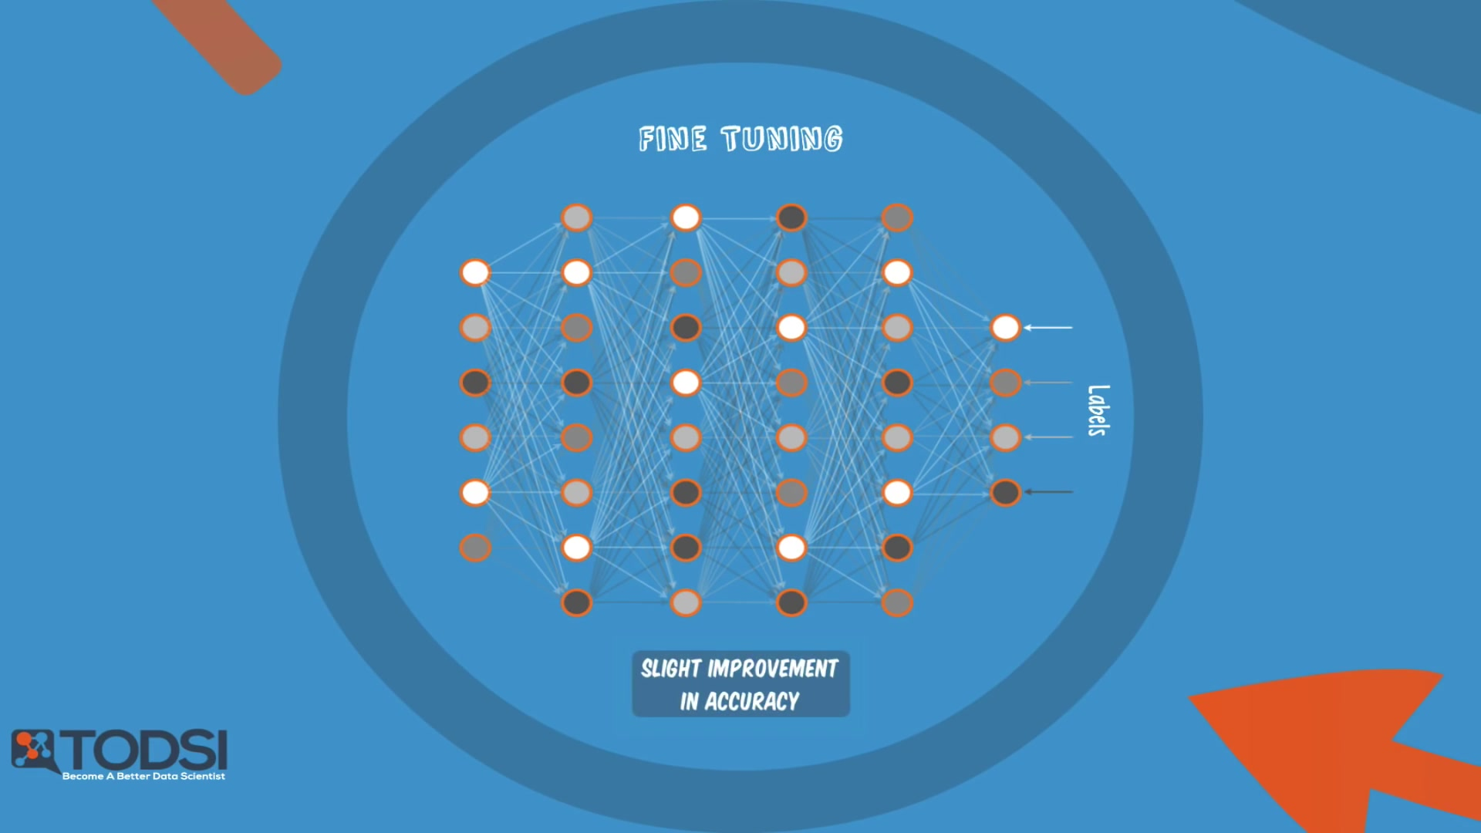
Fortunately, the set of labelled data can be small relative to the original data set, which as we’ve discussed, is extremely helpful in real-world applications.

Slide 21
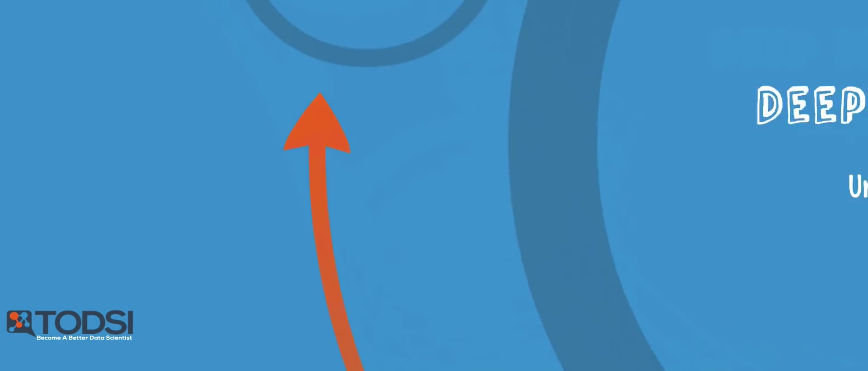
The benefits of a Deep Belief Network

Slide 22
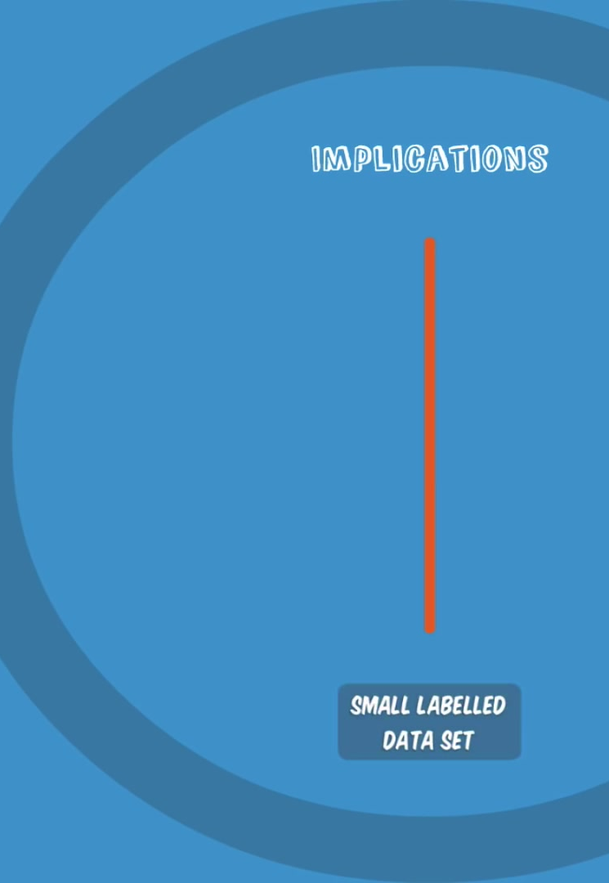
a DBN only needs a small labelled data set, which is important for real-world applications.

Slide 23
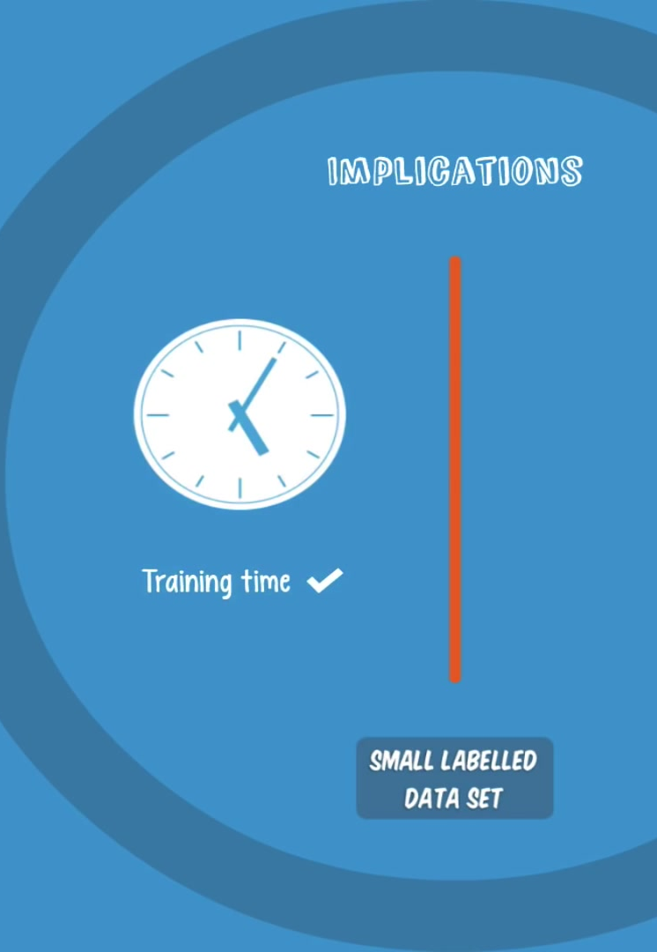
The training process can also be completed in a reasonable amount of time through the use of GPUs.
The resulting net will be very accurate compared to a shallow net

Slide 24
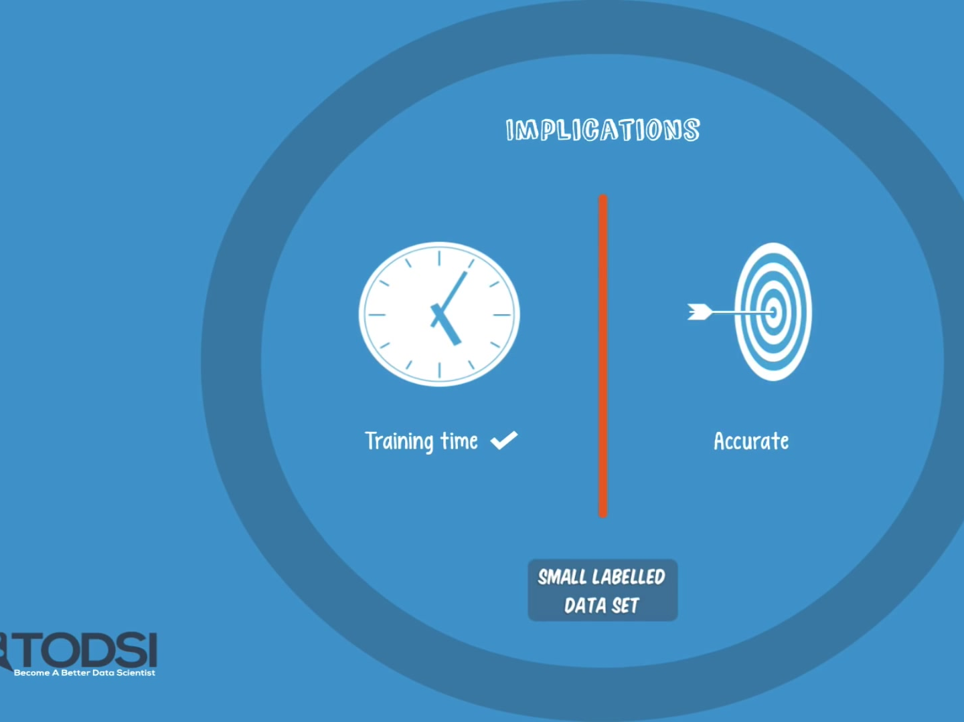
Finally see that a DBN is a solution to the vanishing gradient problem!

Slide 25
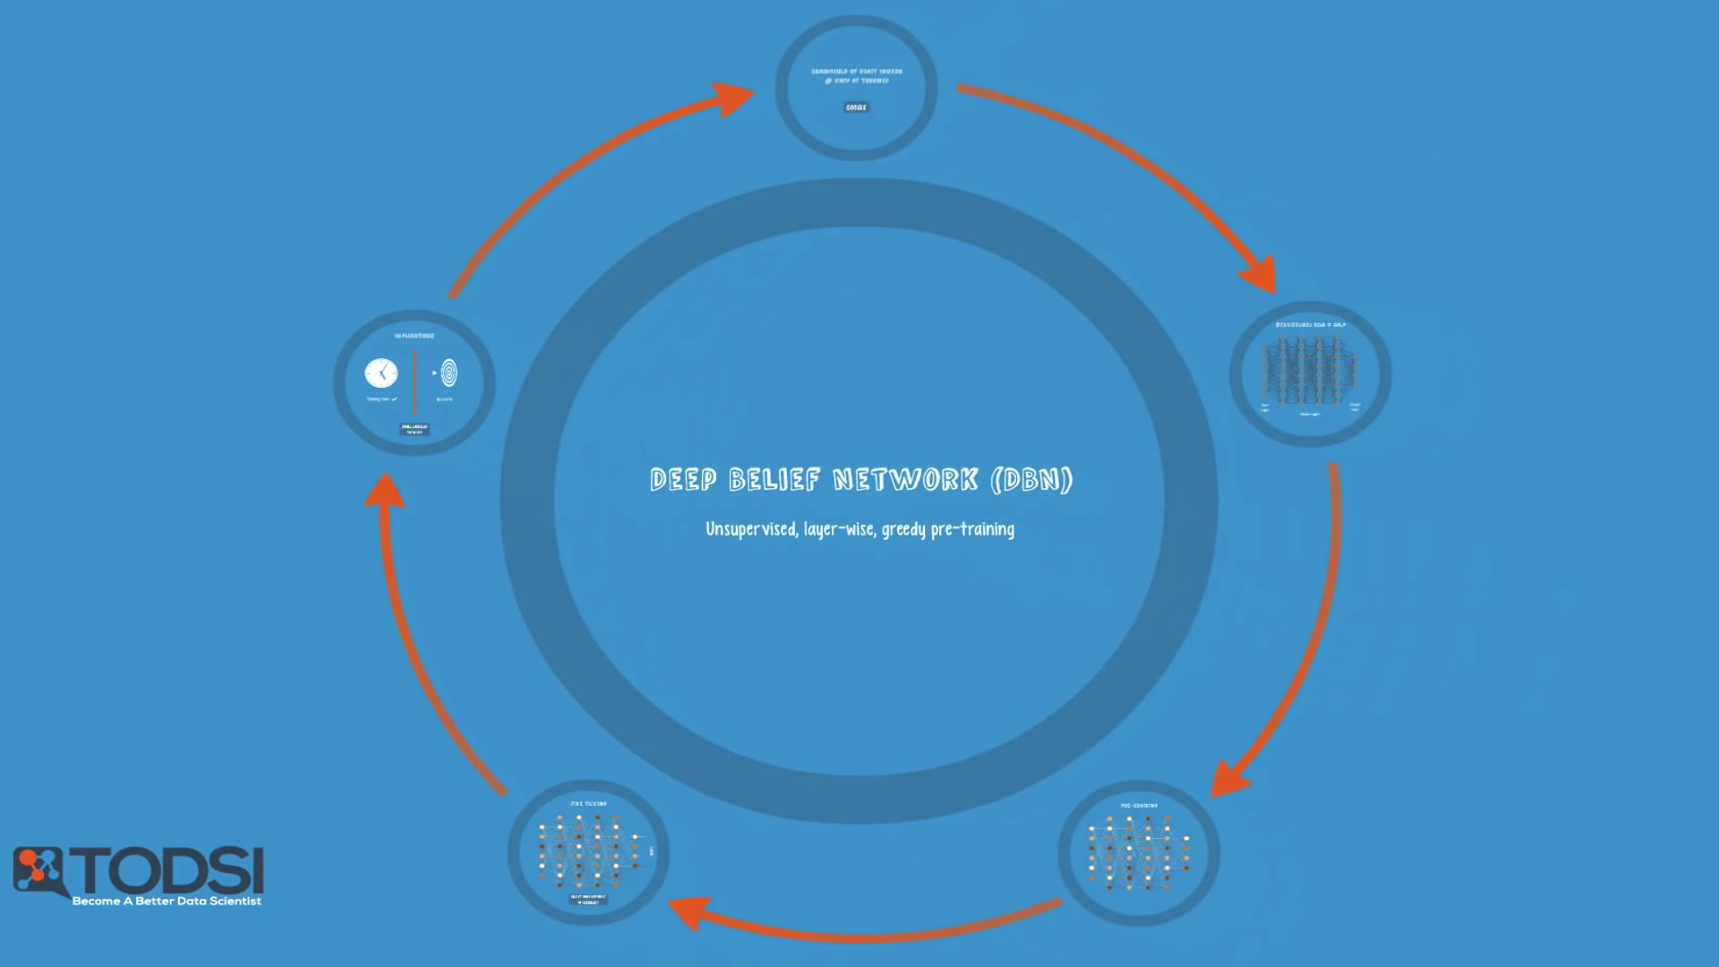
Deep Belief Network (DBN)

Slide 26





IKUTI KAMI
digitalent.kominfo
digitalent.kominfo
DTS_kominfo
Digital Talent Scholarship 2019
Pusat Pengembangan Profesi dan Sertifikasi
Badan Penelitian dan Pengembangan SDM
Kementerian Komunikasi dan Informatika
Jl. Medan Merdeka Barat No. 9
(Gd. Belakang Lt. 4 - 5)
Jakarta Pusat, 10110
digitalent.kominfo.go.id

